Slide 1
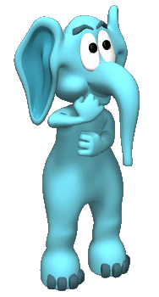
Memory
The persistence of learning over time through the storage and retrieval of information.
ADAPTED FROM www.appsychology.com/appsychPP/appsychology/.../Memory/Memory.ppt
and
www.blinn.edu/socialscience/ldthomas/.../PPT/Griggs_Chapter_05_Memory_DP.ppt

Slide 2
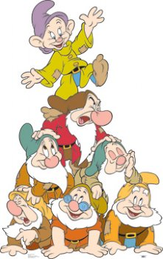
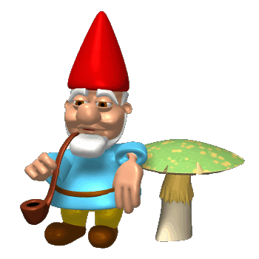
Take out a piece of paper…..
Name the seven dwarves…..
Now name them…..

Slide 3
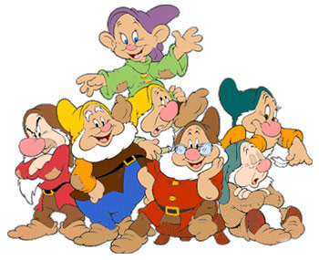
Was it easy or hard?
It depends on several things….
If you like Disney movies?
When was the last time you have seen the movie?
Are people around you being loud so you cannot concentrate?

Slide 4


Recall Versus Recognition
Recall
Recognition
you must retrieve the information from your memory
fill-in-the blank or essay tests
you must identify the target from possible targets
multiple-choice tests

Slide 5
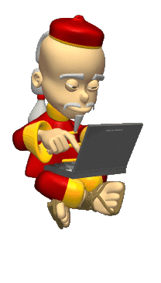

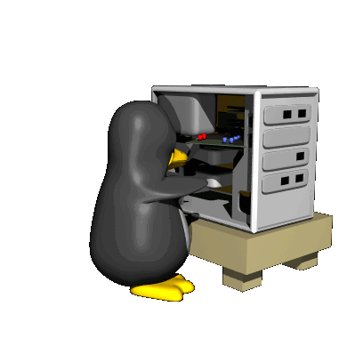
The Memory Process
Three step process….
Encoding: The processing of information into the memory system.
Storage: The retention of encoded material over time.
Retrieval: The process of getting the information out of memory storage.

Slide 6
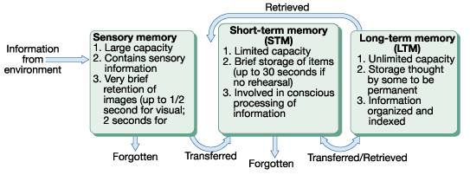
Multistore (Stage)
Model of Memory
Atkinson and Shiffrin

Slide 7
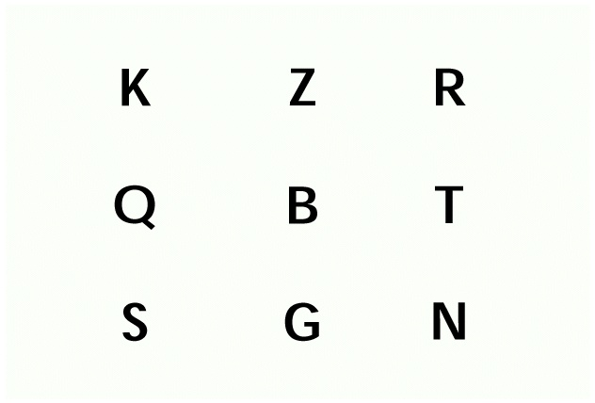

Sensory Memory
A split second holding tank for ALL sensory information.
Sperling’s research on Iconic Memory
Echoic Memory

Slide 8
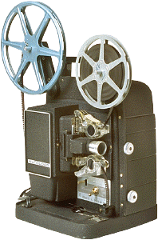
Iconic Memory
Is an exact copy of visual information
  Less than a second in duration
  Very large capacity
Consider the example of a cartoon movie, which is nothing more than a series of still drawings flashed in rapid succession
  Iconic memory allows us to perceive motion in the drawings

Slide 9
Echoic Memory
Is sensory memory for hearing (audition) sounds that have just been perceived.
  About 3-4 seconds in duration
  Very large capacity
For example, someone says something to you while you watch TV. You respond to the sound of their voice – “What?”
Then you realise what they said and you respond; you processed the echoic memory

Slide 10
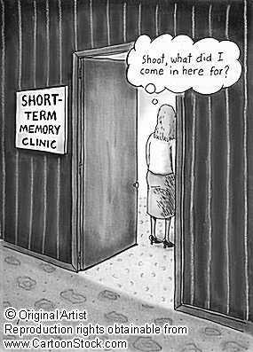
Short Term Memory
The stuff we encode from the sensory goes to STM.
Events are encoded visually, acoustically or semantically.
Holds about 7 (plus or minus 2) items for about 20 seconds.
We recall digits better than letters.
Short Term Memory Activity

Slide 11
Ways to remember things in STM…so they go to LTM
Chunking: Organizing items into familiar, manageable units.
Mnemonic devices
Rehearsal
More frequent rehearsal results in better retention.
1-4-9-2-1-7-7-6-1-8-1-2-1-9-4-1
"Mary Very Easily Makes Jam Saturday Unless No Plums."

Slide 12
Elaborative Rehearsal
Rehearsing information by relating new information to information already in long-term memory
  Contrasts with maintenance rehearsal (i.e., the repetitive cycling of information in short-term memory)
  Elaborative rehearsal provides more retrieval cues to facilitate retrieval
A good way to elaborate on new material is to relate the material to yourself
  The self-reference effect says it is easier to remember information that you have related to yourself because such connections provide more retrieval cues and lend more meaning to the new information

Slide 13
The Working Memory Model - Summary
STM is an active system
STM is a multi-component system
- A central executive; A phonological loop; A visuo-spatial sketchpad
Each slave has both a passive, limited store and an active process
Each slave process has been described by the use of dual-task methodology
The WM model is a flexible and versatile contributor to everyday tasks.

Slide 14
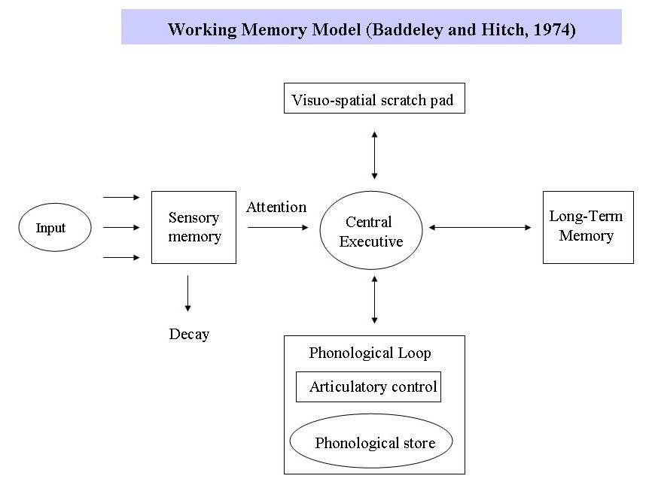

Slide 15
CENTRAL EXECUTIVE
Drives the whole system (e.g. the boss of working memory) and allocates data to the subsystems: the phonological loop and the visuo-spatial sketch pad.
Very active and selects, initiates and terminates processing routines
Prioritising items that require attention at the time, while planning to resolve the current task.
Coordinates inputs and accesses information from LTM in order to achieve the desired result.
It also deals with cognitive tasks such as mental arithmetic and problem solving.

Slide 16
Visuo-Spatial Sketchpad (inner eye)
Stores and processes information in a visual or spatial form.
For example construction and manipulation of visual images; used for representing mental maps
The VSS is used for navigation.

Slide 17
Phonological Loop
Part of working memory that deals with spoken and written material. It can be used to remember a phone number. It consists of two parts
Phonological Store (inner ear) – Linked to speech perception Holds information in speech-based form (i.e. spoken words) for 1-2 seconds.
Articulatory control process (inner voice) – Linked to speech production. Used to rehearse and store verbal information from the phonological store.

Slide 18


INSTRUCTION
Close your eyes and count how many windows there are in the house that you live in.

Slide 19
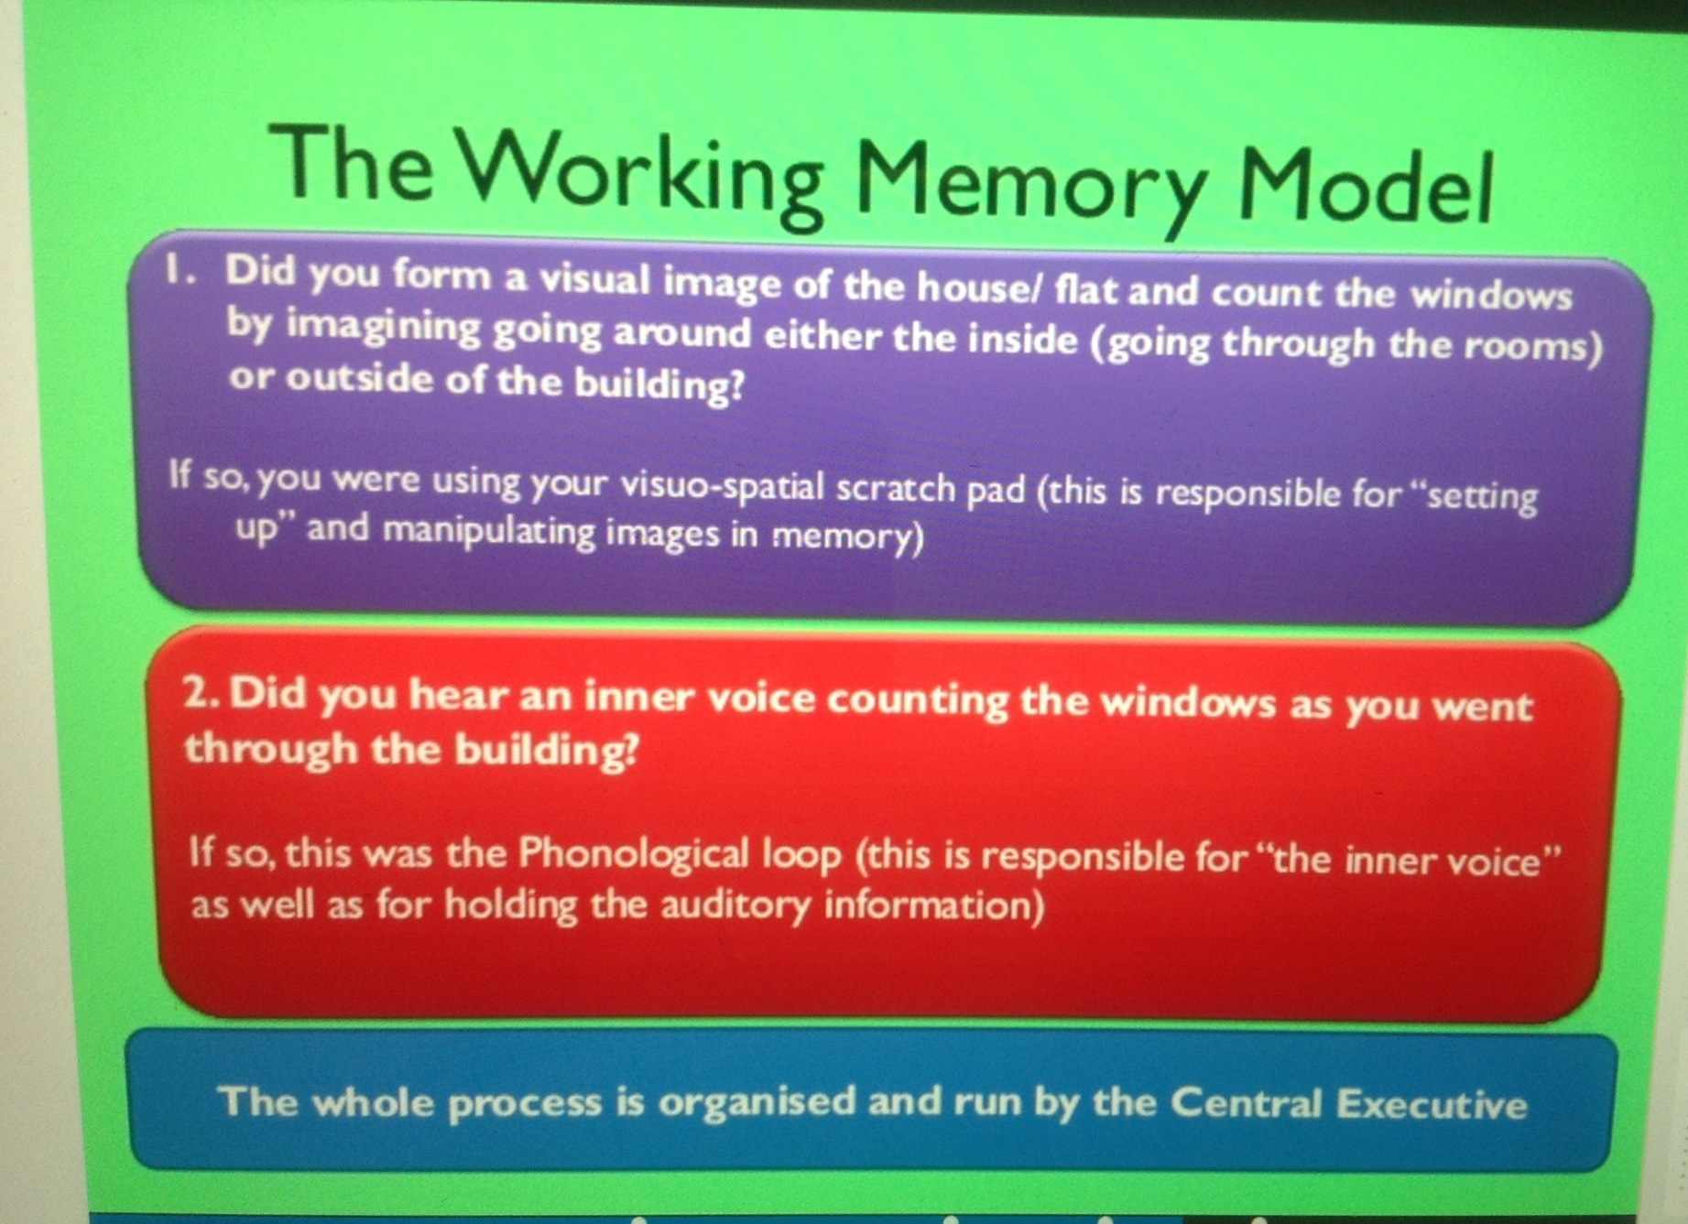

Slide 20
Memory System Processes
Encoding
The process of transferring information from one memory
stage to the next
Storage
The process of maintaining information in a particular
stage
Retrieval
The process of bringing stored information from long-term
memory to the conscious level
in short-term memory

Slide 21
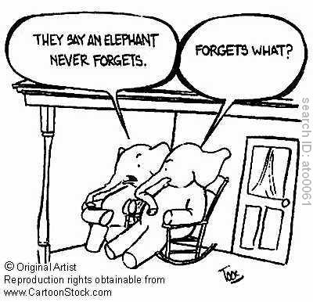
Long Term Memory
Unlimited storehouse of information.
Explicit (declarative) memories
Implicit (non-declarative) memories

Slide 22
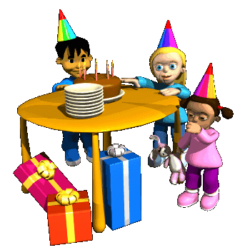

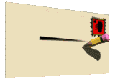
Explicit Memories
Episodic Memories
Semantic Memories

Slide 23
Types of Long-Term Memory
Explicit memory (also called declarative memory) is long-term memory for factual knowledge and personal experiences and requires conscious recall
Two types of explicit memories:
  Semantic memories are memories for factual knowledge that is true of everyone (e.g., the current Prime Minister of Australia; knowing a whale is a mammal)
  Episodic memories are memories for personal life experiences (e.g., your first school ball; 13th birthday party)

Slide 24
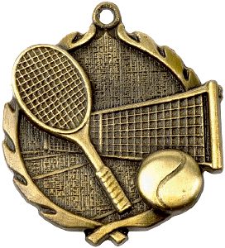
Types of Long-Term Memory
Implicit memory (also called non-declarative memory) is long-term memory that influences our behaviour, but does not require conscious awareness or declarative statements (e.g., for most adults, driving a car; walking)
Some implicit memories are procedural memories because they have a physical procedural aspect to them
  For a tennis expert, such as Serena Williams, the movements to play the game are implicit, procedural memories, whereas for the average person, such movements require conscious recall, and are more semantic memories
  Other implicit memories have become automatic responses to certain stimuli (e.g., feeling tense when police car lights are flashing behind us)

Slide 25
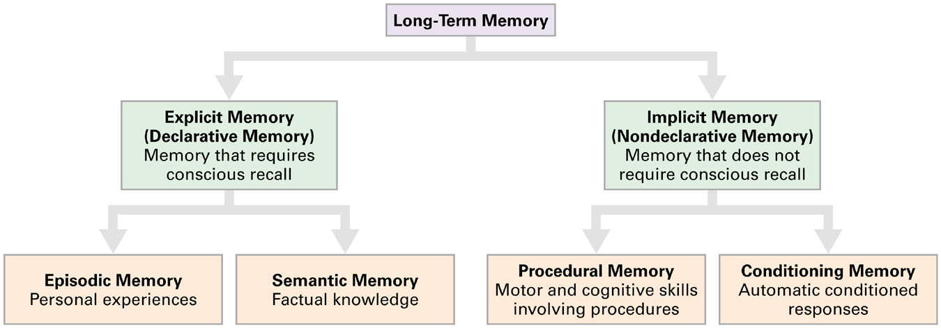
Types of Long-Term Memory

Slide 26
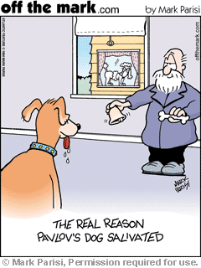
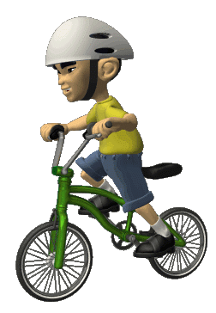
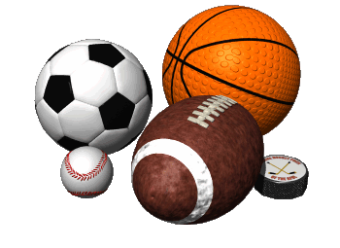
Implicit Memories
Procedural Memories
Conditioned Memories

Slide 27
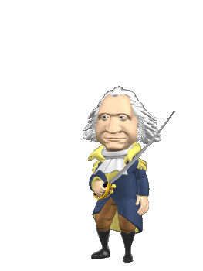
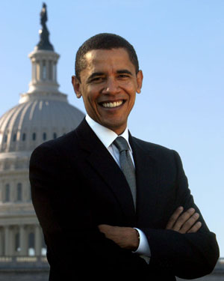
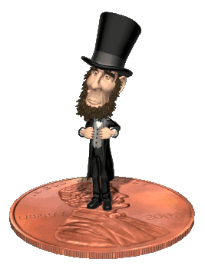
Encoding Information
Primacy Effect
Recency Effect
Serial Positioning Effect

Slide 28
Evidence for the Short-Term vs. Long-Term Distinction
The recency effect is caused by recall from short-term memory, whereas the primacy effect is the result of superior recall from long-term memory of the first few words in the list
  The first few words enter an empty long-term memory and get proportionately more attention than the words in the middle of the list and can thus be transferred into long-term memory
  The last few words are still in short-term memory at the time of recall
  If recall is delayed by having participants count rapidly backward by 3’s for 30 seconds, the recency effect is eliminated, but the primacy effect remains
  To eliminate the primacy effect, simply rehearse each of the items on the list equally

Slide 29

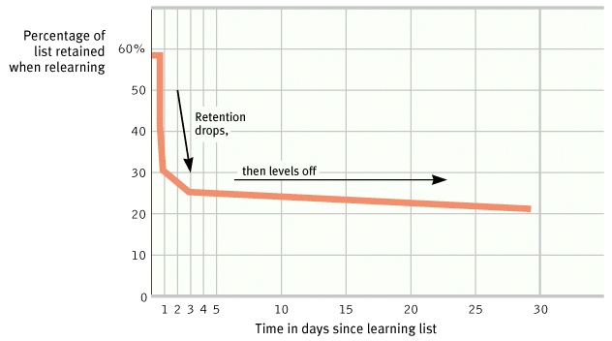
Spacing Effect
DO NOT CRAM!!!!!!!!!!!!
Ebbinghaus’s Forgetting Curve

Slide 30
Other Tips for
Improving Encoding
The spacing effect (or distributed study effect) contends that your memory will improve if you study for an exam over an extended time interval rather than just a few days before the exam
Overlearning is studying material past the point of initial learning, and has been demonstrated to aid in retrieval of that information

Slide 31

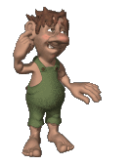
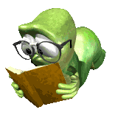
The Ways we can encode…
Encoding Exercise
Visual Encoding: the encoding of picture images.
Acoustic Encoding: the encoding of sound, especially the sounds of words.
Semantic Encoding: the encoding of meaning.

Slide 32
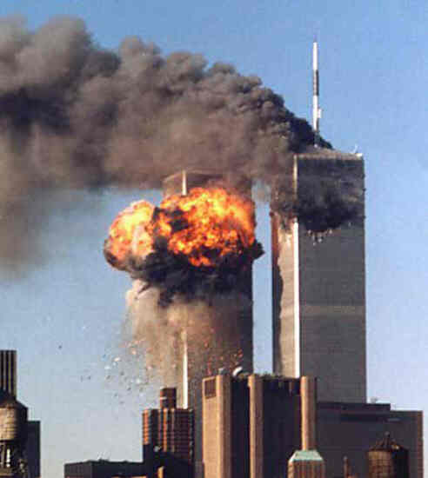
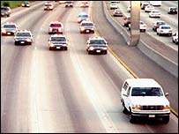
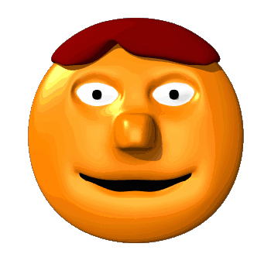
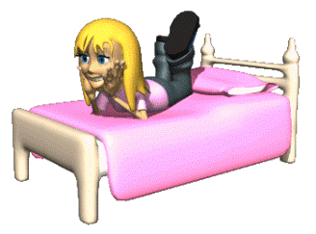
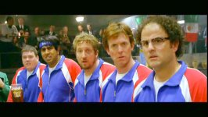
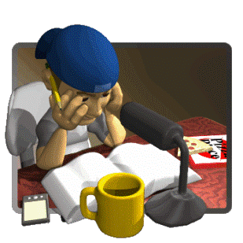
The Context Matters!!!
Flashbulb Memories
Mood Congruent Memory
State Dependent Memory

Slide 33
Environmental
Effects on Encoding
Mood-dependent memory effects attest to the fact that memory is better when a person’s mood is the same during encoding and retrieval
  For example, if you are happy during encoding information, it is easier to retrieve that information if you are happy at the time of retrieval
Mood-congruence effect is the fact that memory is better for experiences that are congruent with a person’s current mood
  For example, when we are sad it is easier to retrieve negative events in our lives

Slide 34
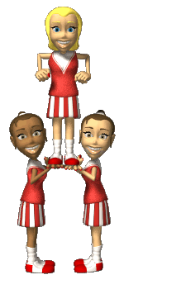
Storing Memories
Long Term-Potentiation
long-lasting enhancement in signal transmission between two neurons that results from stimulating them synchronously.
In other words…they learn to fire together and get better at it…creating a memory.

Slide 35
How to Measure Retrieval
Recall is a measure of retrieval that requires the reproduction of the information with essentially no retrieval cues
Recognition is a measure of retrieval that only requires the identification of the information in the presence of retrieval cues
Relearning, also called the savings method, is a measure of the amount of time saved when learning the information for a second time

Slide 36
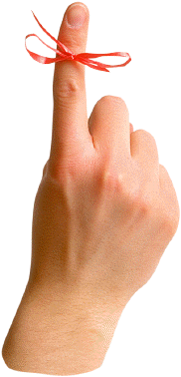
An Early Study
Ebbinhaus conducted the first experimental studies on human memory more than 100 years ago using the relearning method.
He would study a list of nonsense syllables until he could correctly recite the complete list without any hesitations. He then put the list aside and waited some period of time and then relearned the list to the same criterion.
To get a measure of learning, he computed a savings score – the reduction in the number of trials it took him to reach criterion.
Result? The “forgetting curve” reveals that most forgetting occurs in the first two days after learning material.

Slide 37
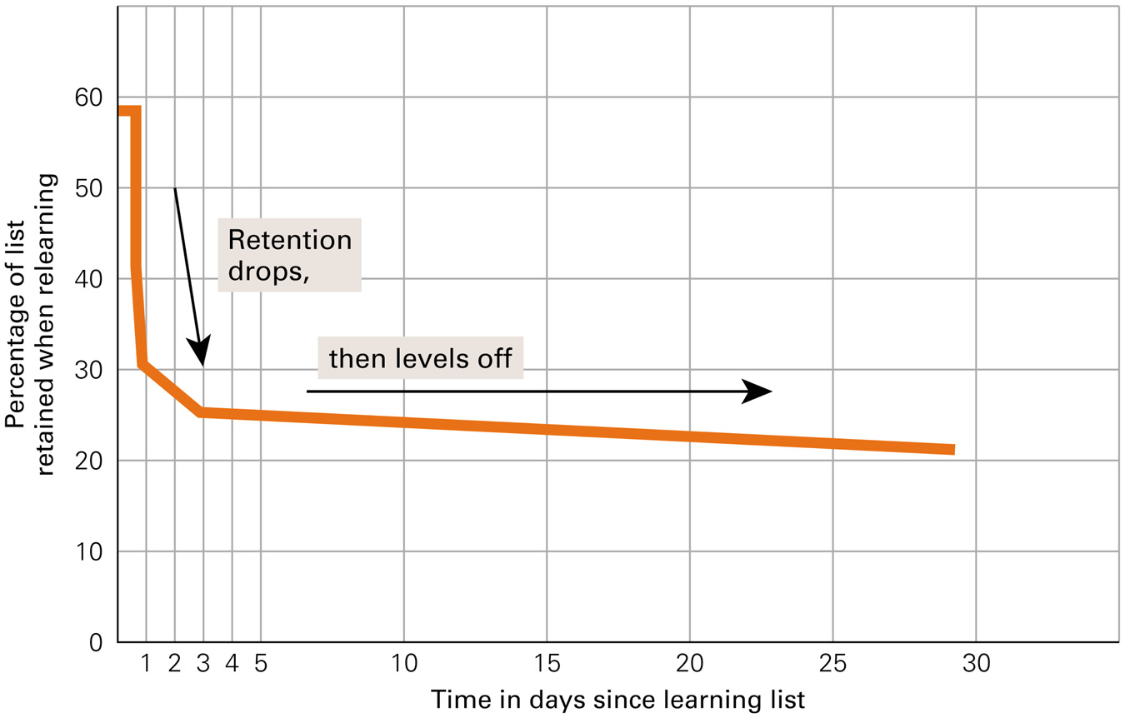
Forgetting Curve for
Long-Term Memory

Slide 38
Why We Forget
Encoding failure theory says that sometimes forgetting is not really forgetting, but rather that the information never entered long-term memory in the first place
Storage decay theory suggests that forgetting occurs because of a problem in the storage of the information
  The biological trace of the memory gradually decays over time and the periodic usage of the information will help to maintain it in storage

Slide 39
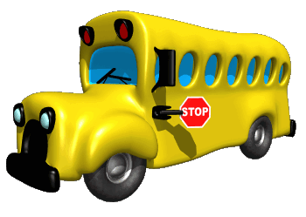
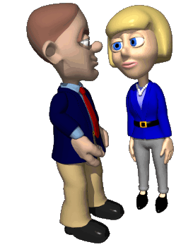
Forgetting
Getting a new bus number and forgetting old bus number.
Retroactive Interference: new information blocks out old information.
Proactive Interference: old information blocks out new information.
Calling your new girlfriend by old girlfriends name.

Slide 40
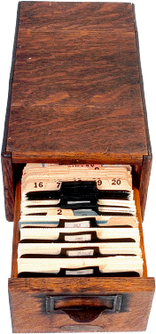
Why We Forget
Cue-dependent theory says we
forget because the cues necessary for retrieval are not available
  The information is in memory, but we cannot access it
  This theory is analogous to knowing a book is in the library but you cannot access it because the library lacks call numbers
Interference theory proposes that other similar information interferes and makes the forgotten information inaccessible

Slide 41
Types of Interference
Proactive interference occurs when information you already know makes it hard to retrieve newly learned information
Retroactive interference occurs when information you just learned makes it hard to retrieve old information

Slide 42
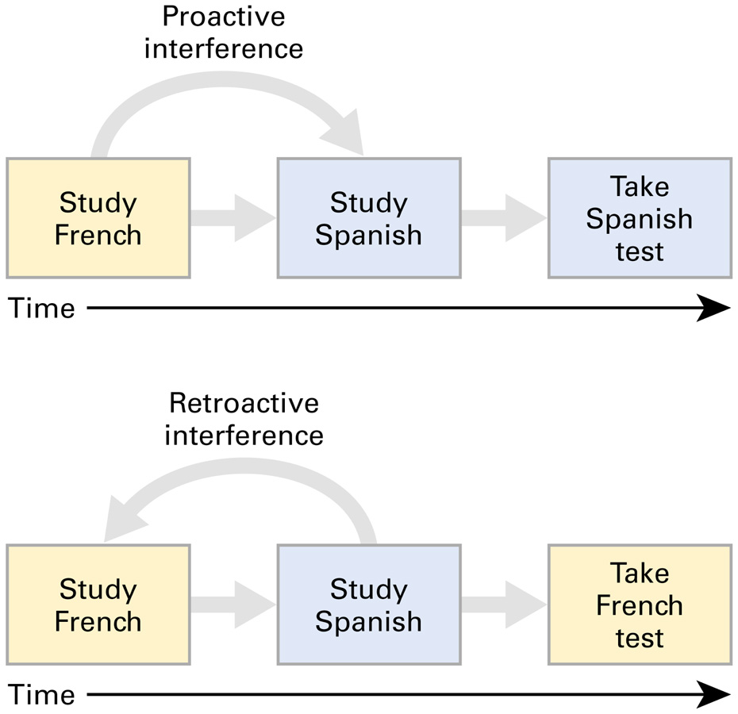
Types of Interference

Slide 43
Types of Interference
Think about changing phone numbers after having a certain number for many years. When asked for your new phone number, remembering the old one interferes with retrieving the new one.
  This is proactive interference
Now think about being at a party with many people you don’t know. You meet someone whom you want to talk to later, but after meeting her, you are introduced to many more people. Now, you cannot remember her name.
  This is retroactive interference

Slide 44
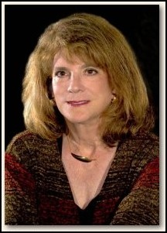
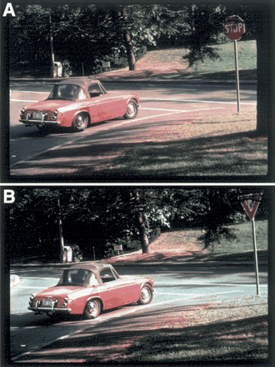
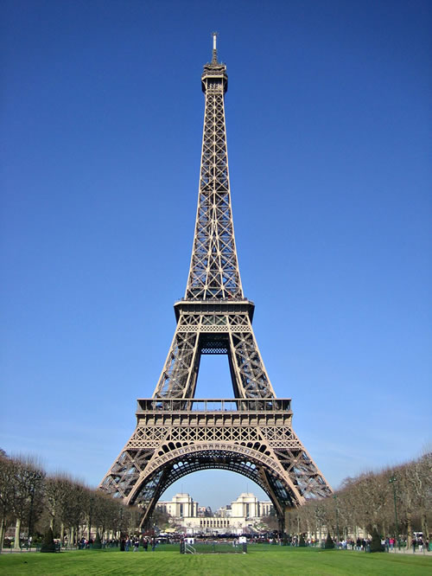
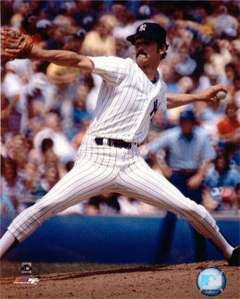
Constructive Memory
Memories are not always what they seem.
Elizabeth Loftus
A constructed memory is a created memory.
Misinformation effect

Slide 45
Source Misattribution
Occurs when we do not remember the true source of a memory and attribute the memory to the wrong source
Source misattribution results in false memories, which are inaccurate memories that feel as real as accurate memories.
False memories can also occur because of the misinformation effect, which occurs when a memory is distorted by subsequent exposure to misleading information

Slide 46
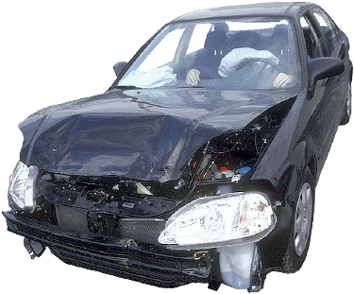
A Study of False Memories
Loftus and Palmer (1974) showed people film of a traffic accident and later tested their memory for the accident
Some people were asked “How fast were the cars going when they smashed into each other?”
and others were asked “How fast were
the cars going when they hit each other?”
Participants asked the first
question estimated a higher
speed at impact and
reported seeing broken
glass when in fact there
was none

